Slide 1
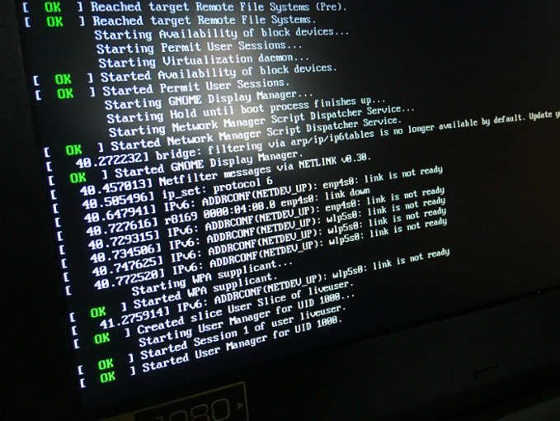
Linux Startup and Shutdown

Slide 2
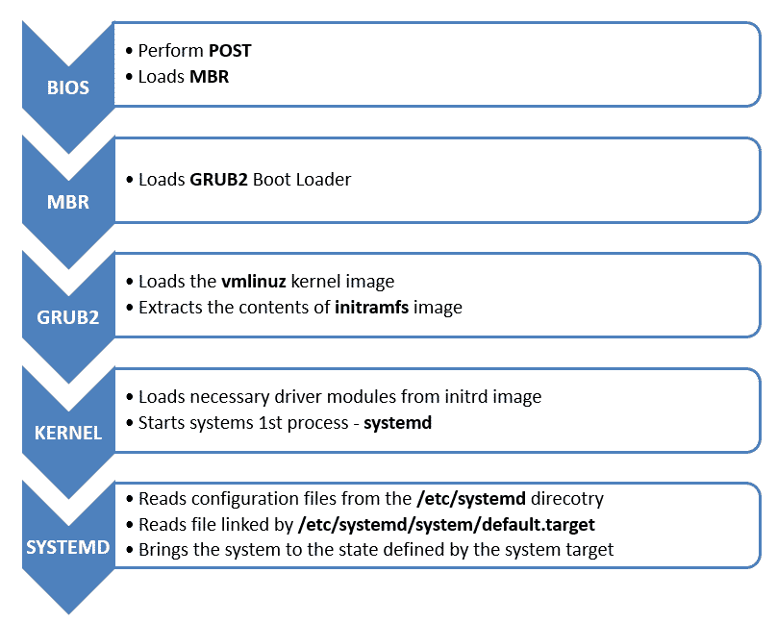

Slide 3

Basic Input/Output System
During Boot Process:
Loads the bootloader program from the Master Boot Record (MBR)
Will search multiple devices (floppy, hard disk, cd drive, usb drive, etc.) for MBR
Allows you to select boot device by pressing a key

Slide 4
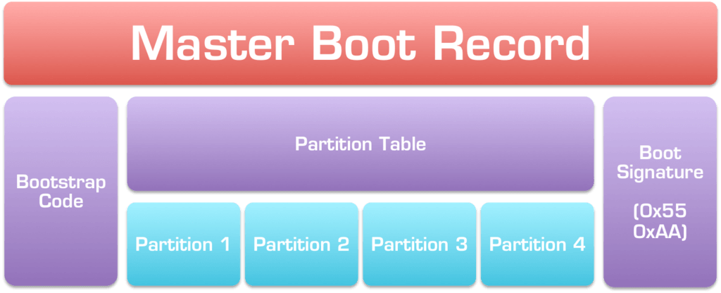
Master Boot Record (MBR)
Located on first sector of boot device
Usually 512 bytes in size
MBR consists of:
bootstrap code
partition table
The primary purpose of the bootstrap code is to find your bootable partition and 'chain' to your bootloader (in our case GRUB2)

Slide 5
Backing up the MBR
Duplicate the first 512 bytes of /dev/sda into the file mbr
sudo dd if=/dev/sda of=mbr bs=512 count=1
dd = data duplicator if = in file of = out file bs = bytes count = number of iterations
$ sudo file mbr $ sudo hexdump mbr

Slide 6
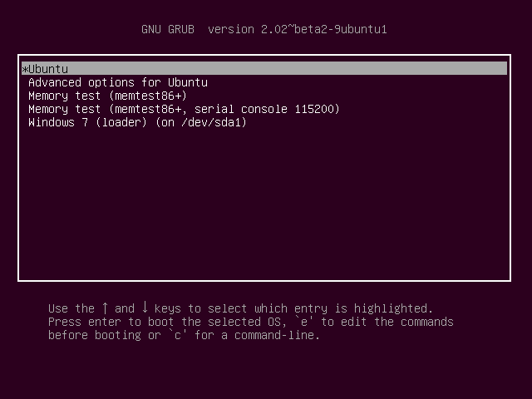
GRUB 2 Bootloader
Stands for GRand Unified Bootloader
If you have multiple kernel images, GRUB will allow you to select from them (including other OSes)
GRUB loads initrd (initial RAM disk) and then the kernel

Slide 7
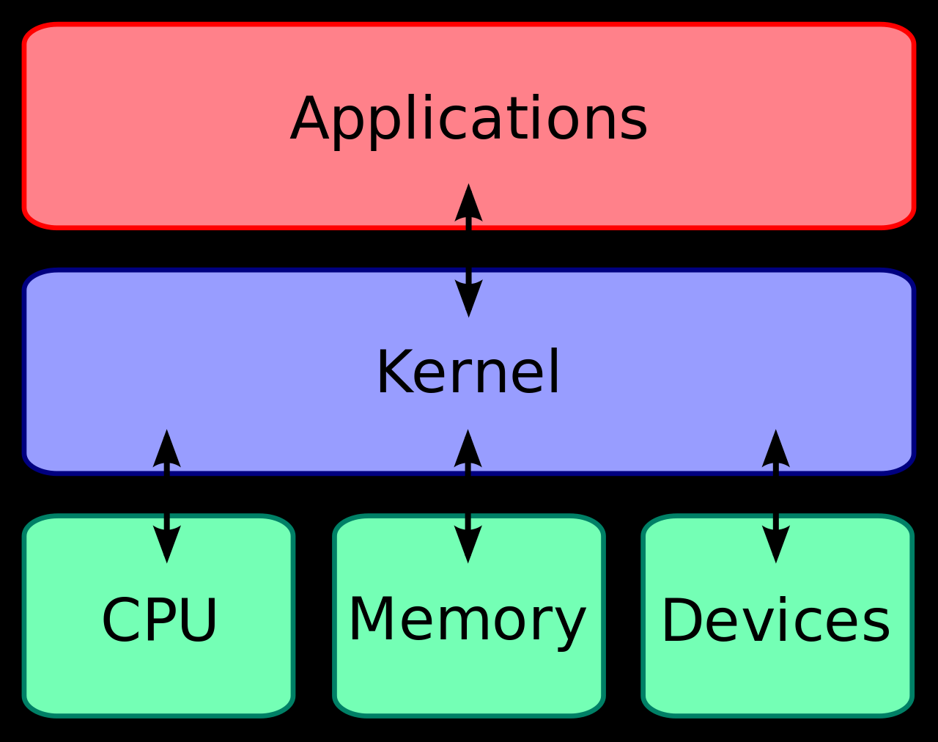
kernel
The kernel is compressed because PC's have no easy way to access all their memory at boot so the initial kernel must load completely within the first megabyte of memory
The head of the file (the first megabyte), puts the CPU into protected mode and removes the memory restriction so that the rest of the kernel can decompress

Slide 8
kernel
Only has access to what is compiled into the kernel, no modules (drivers)​
Must have (at a minimum) code to set up virtual memory and root filesystem
Uses the initrd file system as the root file system until the real one is mounted
Hardware probes determine device drivers to be loaded (drivers are in the initrd file system)
kernel mounts the root file system specified by the root statement in menu.lst
Starts the init process (pid=1)

Slide 9
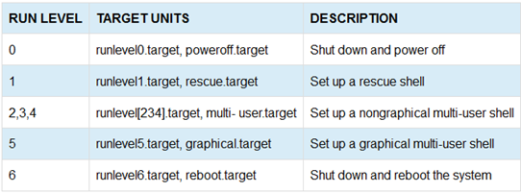
run levels and targets

Slide 10
systemd files and folders
/etc/init - startup scripts for all targets /etc/systemd - home for systemd
/etc/systemd/system - system unit files (startup files) /lib/systemd/system - system unit files (startup files)
/etc/systemd/network - network unit files /etc/systemd/user - user unit files

Slide 11
systemd commands
sudo systemctl list-units sudo systemctl status [unitname].service
Start, Stop, Restart Units
sudo systemctl start [unitname].service sudo systemctl stop [unitname].service sudo systemctl restart [unitname].service
Enable, Disable Unit on Reboot
sudo systemctl enable [unitname].service sudo systemctl disable [unitname].service sudo systemctl isenabled [unitname].service

